Slide 1
WEAPON IDENTIFICATION USING DEEP LEARNING
GUIDE:
Dr. DASARI N V SYAM KUMAR
TEAM:C14 Shaik Dinisha (Y20ACS567) Telagalapudi Olivyaisya(Y20ACS575) Syed Fiza Ruhi Fathima(Y20ACS573) Shaik Sapa Mansoor Ali (Y20ACS564)

Slide 2
Contents
Abstract
Existing System
Proposed System
Design
Implementation
Results
Conclusion

Slide 3
Abstract
Security and safety is a big concern for todays modern world. One of the key aspects of enhancing security is the detection of weapons, which is crucial for preventing threats and ensuring public safety. Traditional methods of weapon detection, such as manual searches have limitations in terms of speed and efficiency. To address these challenges, advanced weapon detection technologies have been developed. The Aim is by using deep learning to detect weapons faster and more accurately than traditional methods.

Slide 4
Existing System
In this existing system they utilized YOLO(You only look once) Model and they have Compared the YOLOV3 and YOLOV4 versions.
They evaluated both the versions based on metrics such as precision, recall and F1 score.
Based on these metrics the YOLOV4 outperformed YOLOV3.

Slide 5
Existing System
YOLOV3 model is used for weapon detection which has given 77% of F1-score ,84% of precision,71% of recall .
YOLOV4 model is used for weapon detection which has given 82% of F1-score, 85% of precision,78% of recall .
The main drawback of the YOLO (You Only Look Once) object detection family is its challenge in accurately detecting smaller objects in an image

Slide 6
Proposed System
Objective:
The objective of this project is to develop a deep learning model to assist public safety organizations in recognizing guns in real-time scenarios to enhance security measures and prevent potential threats.
Methodology: MobileNetV2 object detection algorithm
Here Keras is using as the backend, from that we are importing the MobileNetv2 .

Slide 7
Proposed System
A custom classification head on top of the MobileNetV2 backbone. This head consists of layers such as average pooling, dense, and dropout layers, followed by a softmax layer with the number of output classes corresponding to the number of weapon categories you want to identify.
Benefits:
The Proposed System is able to detect the Smaller Objects When Compared to YOLO model.
Accelerated training iteration speed.

Slide 8
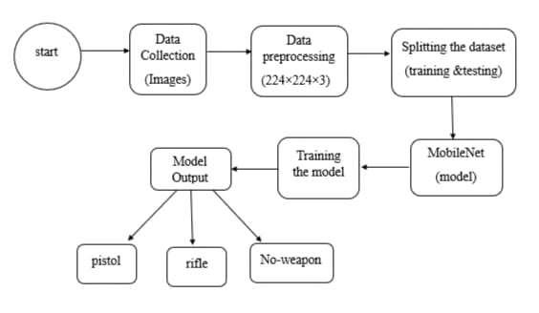
Design

Slide 9
Implementation
In our weapon detection project, MobileNetV2 is used to classify images into three categories: pistols, rifles, and no weapon. The dataset is divided into a training set (80%) and a testing set (20%). The model is trained on the training set to learn the features of each class, and then evaluated on the testing set to assess its performance. Metrics such as precision, recall, accuracy, and F1 score are calculated to measure how well the model is able to correctly classify images into the three categories. These metrics provide insights into the model's performance and help determine its effectiveness in detecting pistols, rifles, and the no weapon in images.

Slide 10
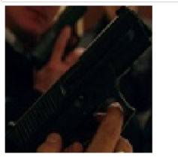
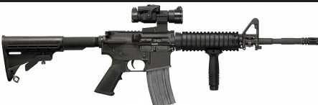
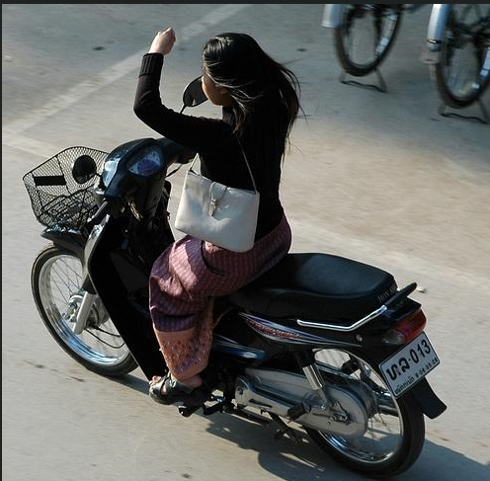
Implementation
Input :The Image will be given as Input
Ex:
Output: The output will be predicted as Pistol or Rifle or No weapon.

Slide 11



Implementation

Slide 12
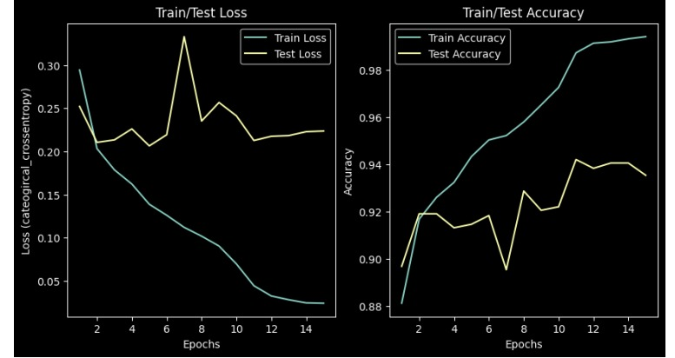
Results
Accuracy: Accuracy is the ratio of correctly predicted instances to the total instances in the dataset. It is a measure of overall model correctness.

Slide 13



Results

Slide 14
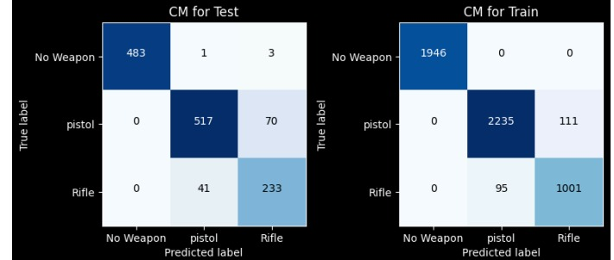
Results Confusion Matrix

Slide 15
Conclusion
The accuracy, precision, recall, and F1 score of a MobileNetV2 model for gun detection is better when comparing with YOLOv3 and YOLOv3. So the performance of the MobileNetV2 model is better than YOLOv3 and YOLOv3.
For future work, further optimization of the model could be explored to improve its performance in challenging scenarios, such as low-light conditions. Additionally, integrating MobileNetV2 with other technologies, could enhance the overall detection capabilities of security systems.

Slide 16
Thank you

